Slide 1

The Forecast Process
Bipasha Mohapatra

Slide 2

About Me
Demand planner for
3 years in
Security Business group and Mass Infrastructure group
Business Transformation and Data Analytics Leader
10+ Yrs. in Cisco
Operations, Manufacturing, and
Planning
Field Exp- 15 yrs. in Operations and Supply Chain
Cisco, TE Connectivity
Bipasha Mohapatra

Slide 3


Basic Forecasting Approaches
Quantitative
Qualitative
Focuses on HARD DATA
Ex: Historical sales, economic indicators
HUMAN element of sales predictions
Ex: opinions, feedback
Notes:
Numerical facts and historical data to predict upcoming events.

Slide 4
The Macroeconomy
Competition
Lead Times
Promotions and Incentives
Seasonality
Company Strategy
Customer Insight
Impacting Factors

Slide 5
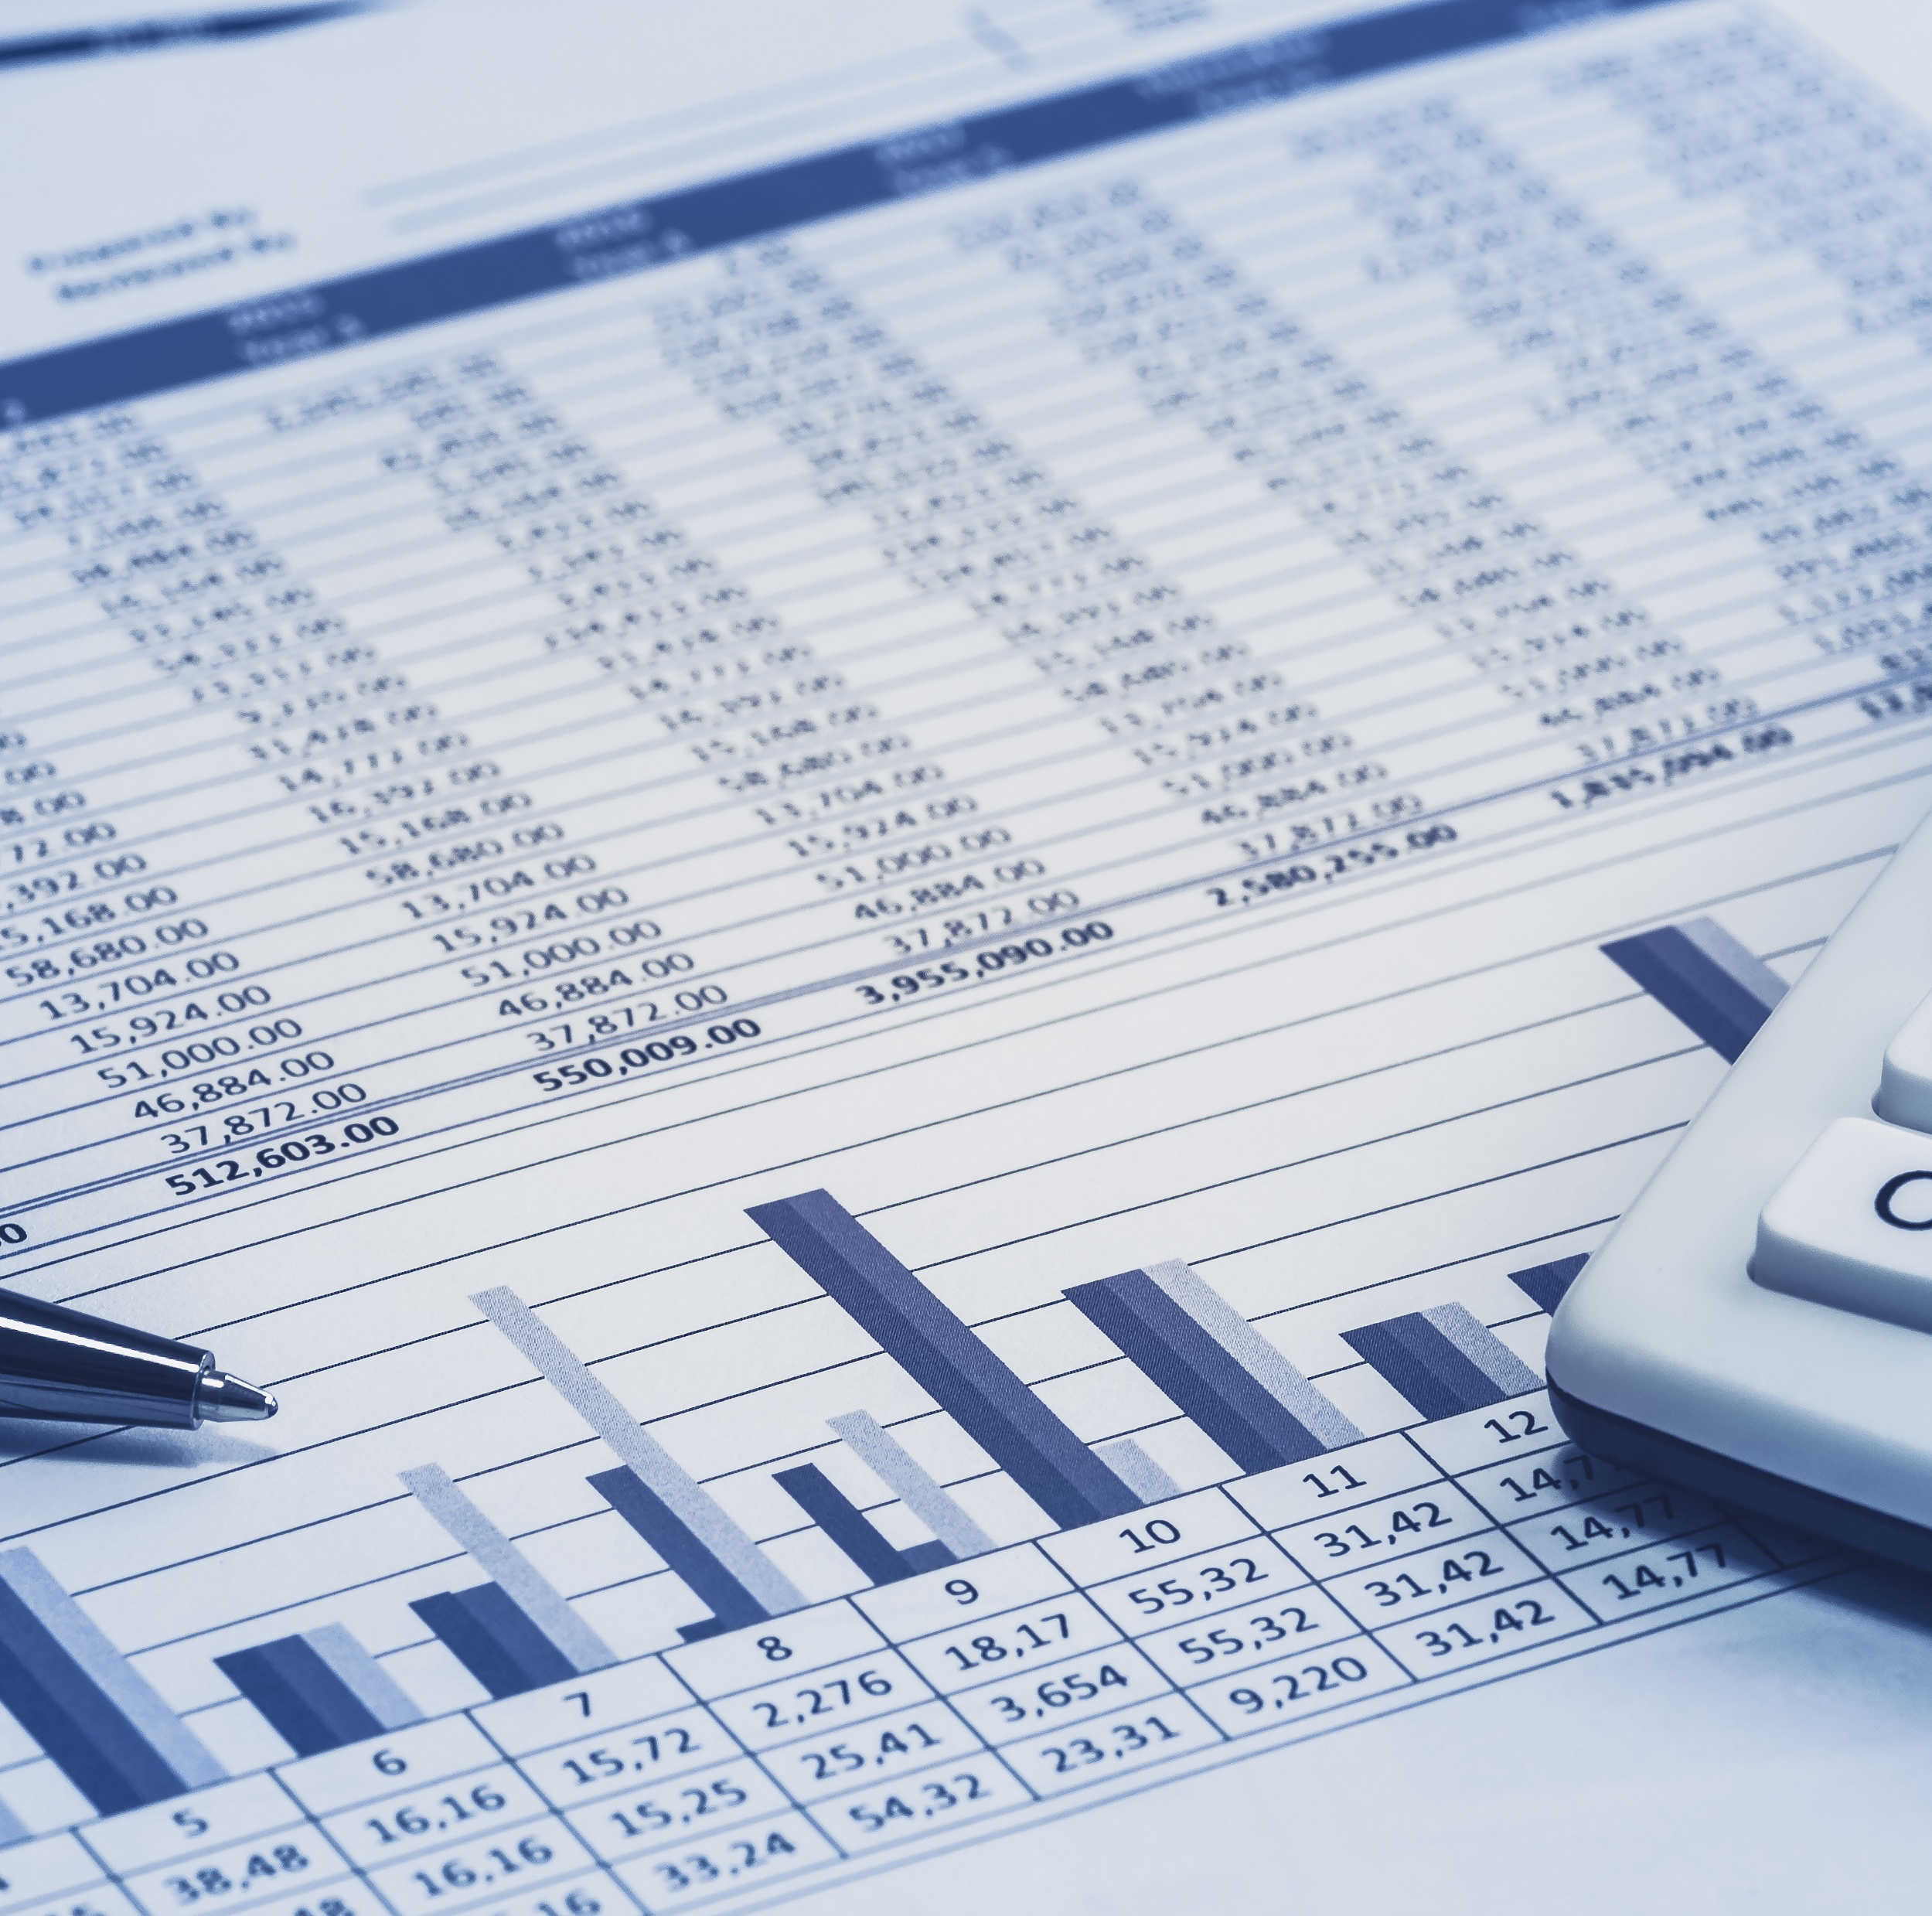
Step 1 Pull the data
The more relevant data you have, the easier it could be to predict your future forecast

Slide 6

Step 2 Merge Data sets
Add in Historical Bookings
Add in all forecast streams
Insert accuracy Performance

Slide 7
Creating a Forecast: Establishing Linearity
Are there anomalies?

Slide 8


Remove the anomalies from the historical data
Calculate Growth rate
Is there a trend?
Q1 seems to be the strongest quarter
Q4 seems to always reflect some Q/Q decline

Slide 9
Forecast Streams and performance
Which stream has the best accuracy?
Is any of the stream showing persistent bias?
Forecast Streams Performance

Slide 10
Step 3 Analyze Data
Seasonality
Is there one month in the quarter that tends to be stronger than the others?
Calculate Y/Y %
Does your future forecast align to business strategy?
Find meaningful patterns
Calculate Q/Q %
Does your quarter over quarter growth assumption align with historical linearity?

Slide 11
Step 4 : Establishing a Future Forecast -Collaborate
Questions to Ask:
What is the PLC?
Is there a persistent bias?
Is there a seasonality?
What caused the anomaly?
Are there differences in the streams?

Slide 12

Finalize your forecast
PLC
Growth Rate
Best Stream performance
Bias
Judge
Consensus

